Slide 1
Hide/Unhide Package/Title-Package: eHoldings App
January 8, 2018

Slide 2
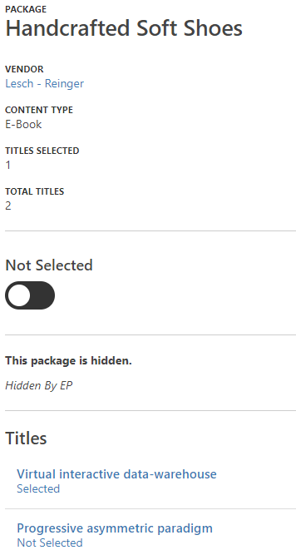
eHoldings app: Package Detail Requirements
For Package Detail
Display a Show/Hide Toggle
Remove “This package is hidden” message
Replace “Hidden by EP” message with Set by System message display to the right of the toggle.
List of Titles section
If a title is set to hide then display the message “Hidden” to the right of “Selected/Not Selected” Message.

Slide 3
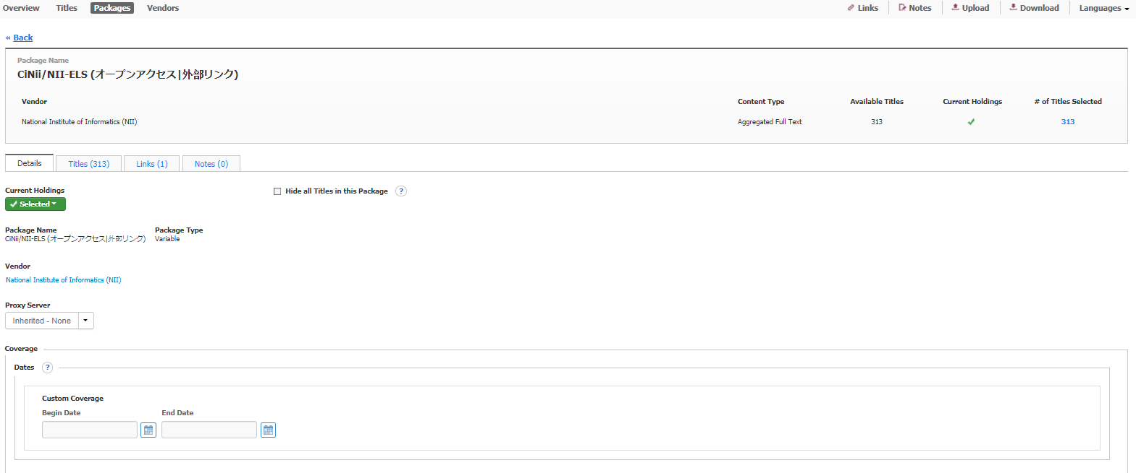
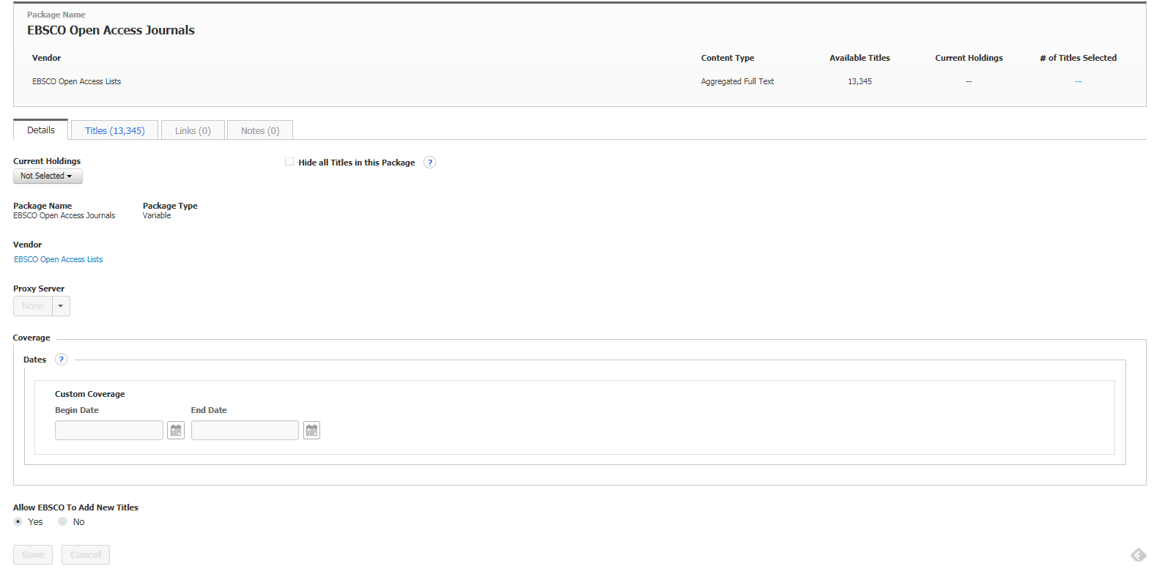
HLM Screen: Package Details
Screenshot represents a package detail record not selected. Assume user is unable to edit unless package is selected.

Slide 4
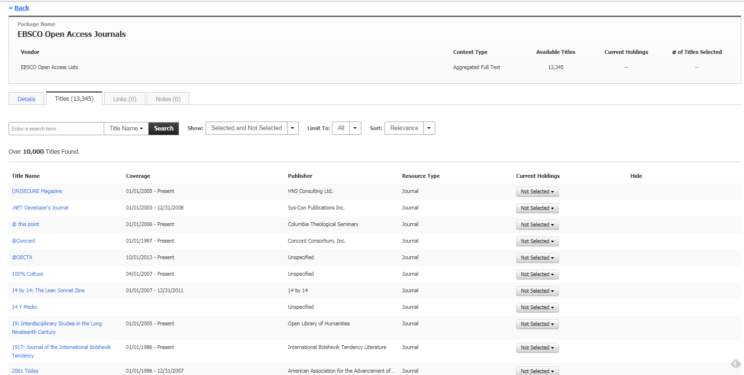
HLM Screen: Package Details: Title List Tab

Slide 5
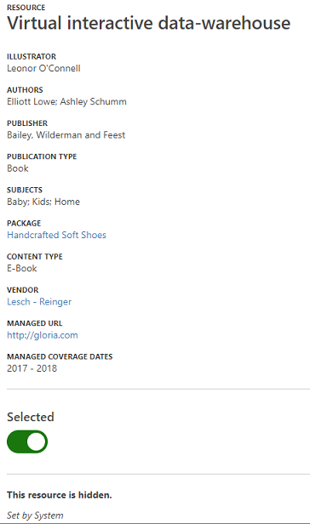
eHoldings app: Title – Package Requirements
Title-Package Detail
Show/Hide label is conditional based on current state
Display a Show/Hide toggle
Remove “This resource is hidden.” messaging
If the entire package is not hidden by the system and it is only that title-package then display Set by System to the right of the Show/Hide toggle.
This resource is hidden messaging should not display
If the user sets package to hide AND the title-package is selected then disable the Show/Hide toggle and display a message to the right of the toggle [All titles in this package are hidden.] on the title-package record.
If the system sets package to hide then display this message to the right of the toggle [All titles in this package are hidden.] on the title-package record.
If the user/system has not set the package to hide AND the title-package is selected then enable the Show/Hide toggle.

Slide 6
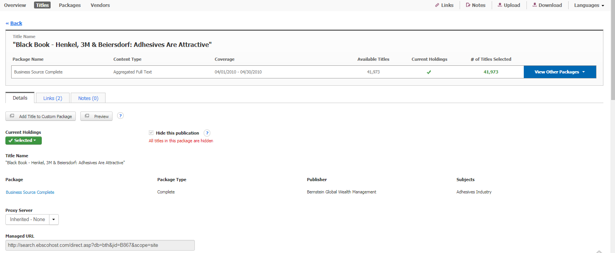
HLM Screen: Title – Package Details: Messaging: Title hidden
If the user has set on the package details record to hide all titles in package. Then all titles selected in that package will be hidden and on the title – package detail record the following message will display

Slide 7
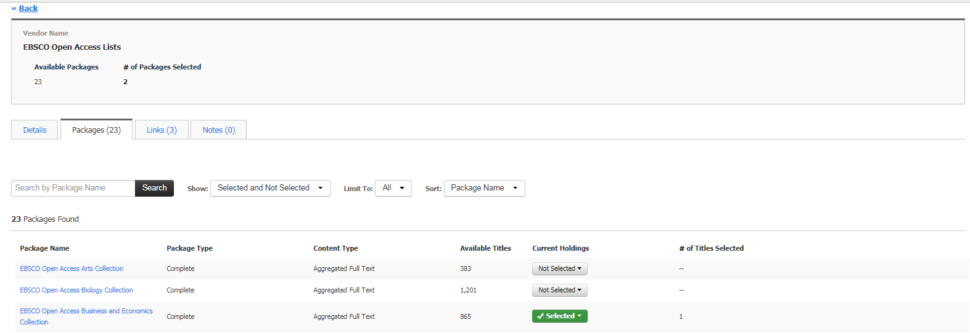
Vendor Details: Packages Lists Tab
HLM Screen: Vendor Requirements
eHoldings app Requirement: If entire package is set to hide then display “Hidden” for that package under the List of Package.

Slide 8
When to display the message: Set by System

Slide 9
2. System Override Coverage Date
EBSCO Override Setting Indicator
Given the title-package or package was ordered through EBSCO Subscription Service (ESS)
When
Order has not been renewed (iow Subscription date has expired)
Future order (iow Subscription has not begun)
Outside of managed coverage date
Or order does not provide institutional access
Then ESS can override the following HLM settings for the following fields:
Hide this publication
AND
If customer had Managed Coverage selected then Coverage Information selection becomes Custom Coverage
ESS Populates Custom Coverage values
IF Order has not been renewed (iow Subscription date has expired) then Custom Coverage start = Blank AND Custom Coverage end = No Access
IF Future order (iow Subscription has not begun) then Custom Coverage start = display date provided by ESS AND Custom Coverage end = display date provided by ESS
IF subscription order is outside of managed coverage date then Custom Coverage start = display date provided by ESS AND Custom Coverage end = display date provided by ESS
NOTE: RM API should handle this business logic.
ANOTHER USE CASE: If user sets a custom coverage date on the Package Detail Record and the Title- Package Coverage Date date range is not within the Package’s custom coverage then that Title-Package will automatically be set to hide. See next slide for example.

Slide 10
HLM:Title - Package Details: System Messaging when coverage date is completely out of package coverage date
The Package Coverage Date is set with begin 01/01/1900 and end 01/01/2013.
The begin date of this publication is 05/06/2016

Slide 11
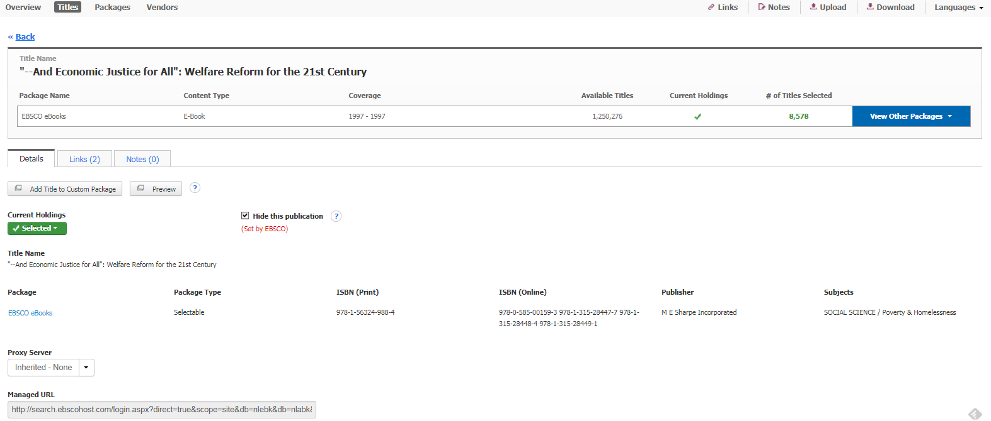
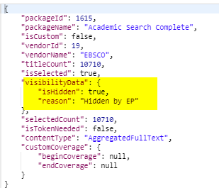
Title – Package Details: Messaging: Title set to hide by EBSCO
HLM: Title – Package Details: Messaging: Title set to hide by EBSCO
Screenshot represents a title – package detail that was set to hide by EBSCO. Via RM API you should get the following response

Slide 12
Show/Hide Expectations
Scenario | Set by User (Y/N) | Package Label and Toggle Displays | Title Package and Toggle Displays
Set Package to Hide | Y | Label State = Hide Toggle State = Hide | Label State = Hide Toggle State = Hide Toggle is read-only Display message that all titles in package are hidden
Set Package to Hide | N | Label State = Hide Toggle State = Hide - Display message: Set by System | “ “
Set Title-Package to Hide AND not set at package | Y | N/A | Label State = Hide Toggle State = Hide
Set Title-Package to Hide AND not set at package | N | N/A | Label State = Hide Toggle State = Hide - Display message: Set by System
Set to Show (default state) | Y | Label State = Show Toggle State = Show | Label State = Show Toggle State = Show

