Slide 1
eHoldings App: Custom Coverage
Jan 26, 2018

Slide 2
What is an embargo?
Some publishers do not make all the articles in a journal available online as soon as it published. Some publishers will make articles available online for several days to several years after publication. There is no standard.
The time frame for when a publisher will make all articles in a journal available in a given package is called an embargo.
An embargo is set at the title-package level only.
Why? Because embargoes may differ across packages due to relationships publishers have with Providers.
If EPKB (aka EBSCO’s knowledge base) is aware of an embargo then it will return this information in the RM API response. It is called a managed embargo.
A eHoldings app user can also add a custom embargo regardless of the presence of a managed embargo.
An embargo is represented in units of time:
Days
Weeks
Months
Years
Managed Embargo Example: Title: New Review of Academic Librarianship in Package: Library, Information Science & Technology Abstracts with Full Text
Has an 18 month embargo.
It means all articles in this journal will be available online 18 months after these articles were published.
Custom Embargo Example: Title: Science & sports in Package: Science Direct
Has an 1 week embargo.
It means all articles in the journal will be available online 1 week after these articles were published.

Slide 3
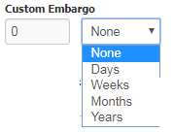
Requirements
Have a field called Custom Embargo that is only editable when title-package has been selected.
Provide a way for a user to:(see screenshot)
Enter a number
Select a unit of time: days, weeks, months, years.
Ability to remove Custom Embargo. Currently EBSCO HLM’s adds “None” in the unit of time dropdown as a way to remove Custom Embargo (see screenshot). When you select None then the number defaults to 0. NOTE: Will need to discuss with Jeffrey if it is okay to move forward with this approach.

Slide 4
Requirements cont’d
Error handling
Do not allow a user to enter non-integers.
IF user enters zero
AND specifies days, weeks, months, and years then display the following message : Please enter a number greater than 0.
Display Rules
Custom Embargo is only enabled when the title-package is selected.
Otherwise when title-package is not selected it is not editable.
Custom Embargo is not retained when the user unselects a title. All values are gone and reset to default.
It does not impact managed embargo.
Ideally it would be nice to display Custom Embargo below Managed Embargo when it is present. When Managed Embargo is not present then display Custom Embargo below Custom Coverage

Slide 5
RM API
Get /{custid}/vendors/{vendorid}/packages/{packageid}/titles/{kbid}
Request Response:
"customCoverageList": [
{}
],
"coverageStatement": "Issues on or after 6/1/1992",
"managedEmbargoPeriod": {
"embargoUnit": "Days",
"embargoValue": "1"
},
"customEmbargoPeriod": {
"embargoUnit": "Days",
"embargoValue": "1"
},
PUT /{custid}/vendors/{vendorid}/packages/{packageid}/titles/{kbid}
bodyoptionc
{
"isSelected": true,
"customCoverageList": [
{
"beginCoverage": "2003-01-01",
"endCoverage": "2003-12-12"
}
],
"coverageStatement": "2009 - 2009",
"customEmbargoPeriod": {
"embargoUnit": "Days",
"embargoValue": "1"
}
}

Slide 6
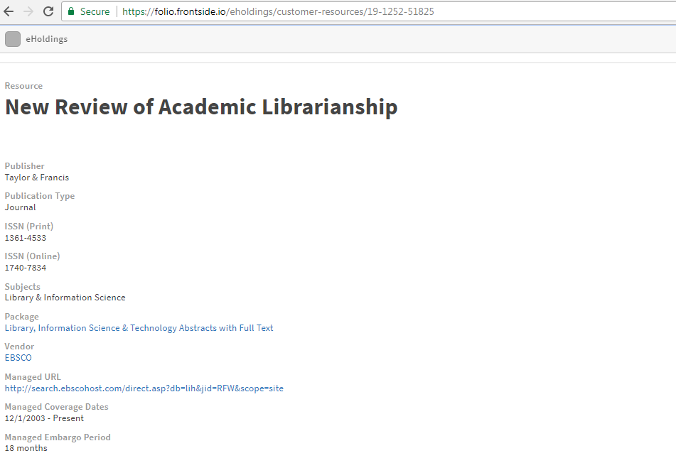
Managed Embargo Screenshot
https://folio.frontside.io/eholdings/customer-resources/19-1252-51825

Slide 7
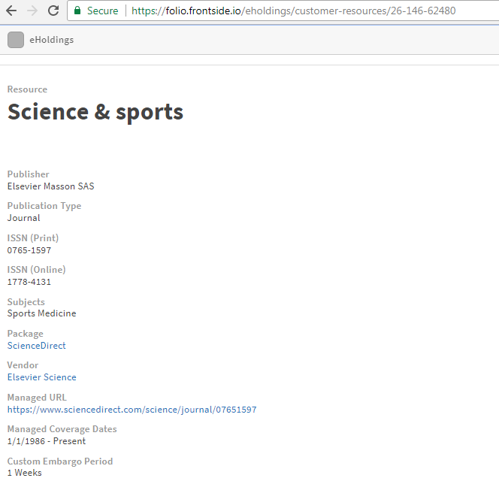
Custom Embargo Screenshot
https://folio.frontside.io/eholdings/customer-resources/26-146-62480
NOTE: Currently, the eHoldings app does display Custom Embargo as a read-only value.
Work is needed to allow a user to edit Custom Embargo when the title-package has been selected.
Can we keep the highlighted treatment when the title-package is not selected? Something to discuss w/ Jeffrey.

