Slide 1
Linking and Unlinking Data Import Profiles
Ann-Marie Breaux
16 Oct 2019

Slide 2
Key principles
Job profile
Link 0 or 1 match profile
Link 1 or more action profiles
Do not link field mapping profiles (will be linked to their respective action profiles)
The sequence of the linked match and action profiles is a key part of the job profile
Match profile
No links can be made on a match profile
Linked job profiles show on the match profile, but cannot be linked via the match profile (can only be linked from the job profile)
Action profile
Link 0 or 1 field mapping profile
Linked job profiles show on the action profile, but cannot be linked via the action profile (can only be linked from the job profile)
Field mapping profile
Link to 0, 1, or more action profiles
No job profiles show on the field mapping profile
Can only link on the profile’s Create/Edit screen, not on the View details screen
No trashcan – we’re linking/unlinking, not creating/deleting
For MVP, assume profiles already exist and are just being linked. Cannot create a profile “on the fly” during the linking process
View details screen is already OK – we just need to update the Create/edit screens for Action and Field mapping profiles

Slide 3
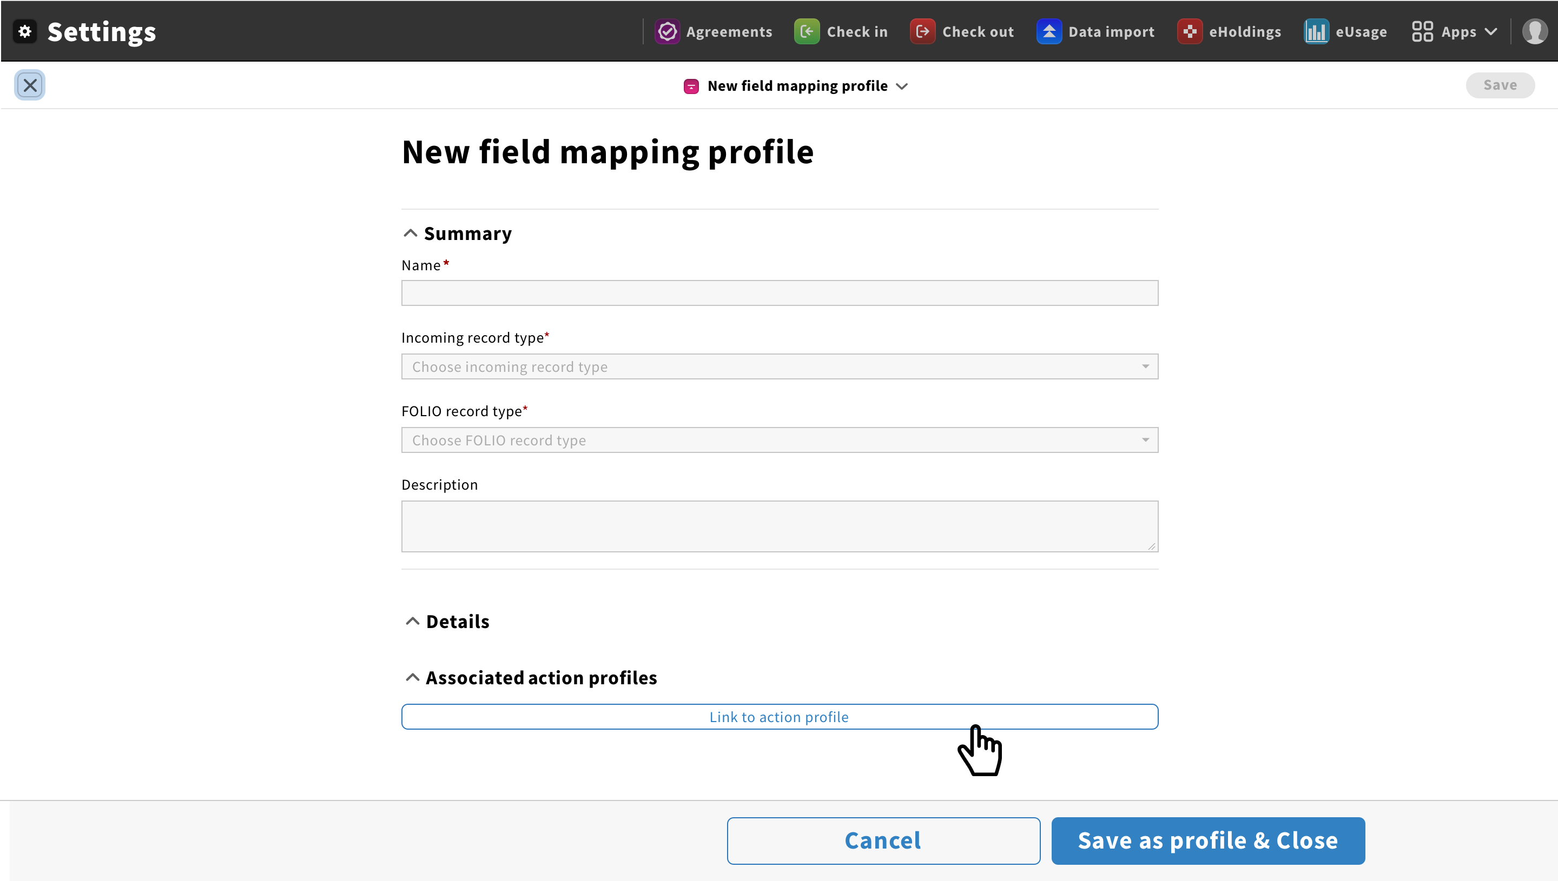
Field mapping profile: link action profile: 1
Add button to create/edit screen
Link profile

Slide 4
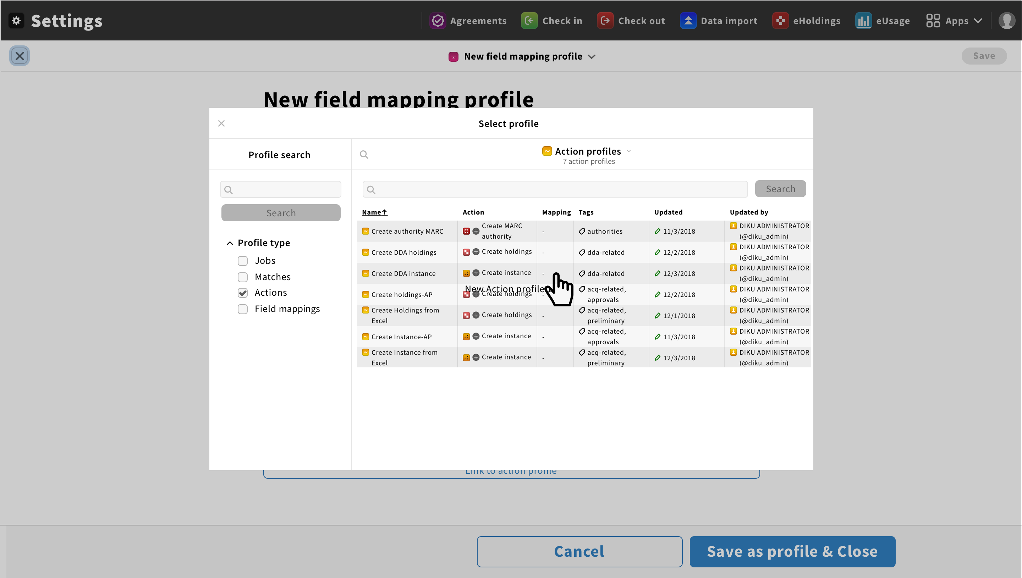
Field mapping profile: link action profile: 2
Opens profile picker modal, filtered to action profiles only

Slide 5
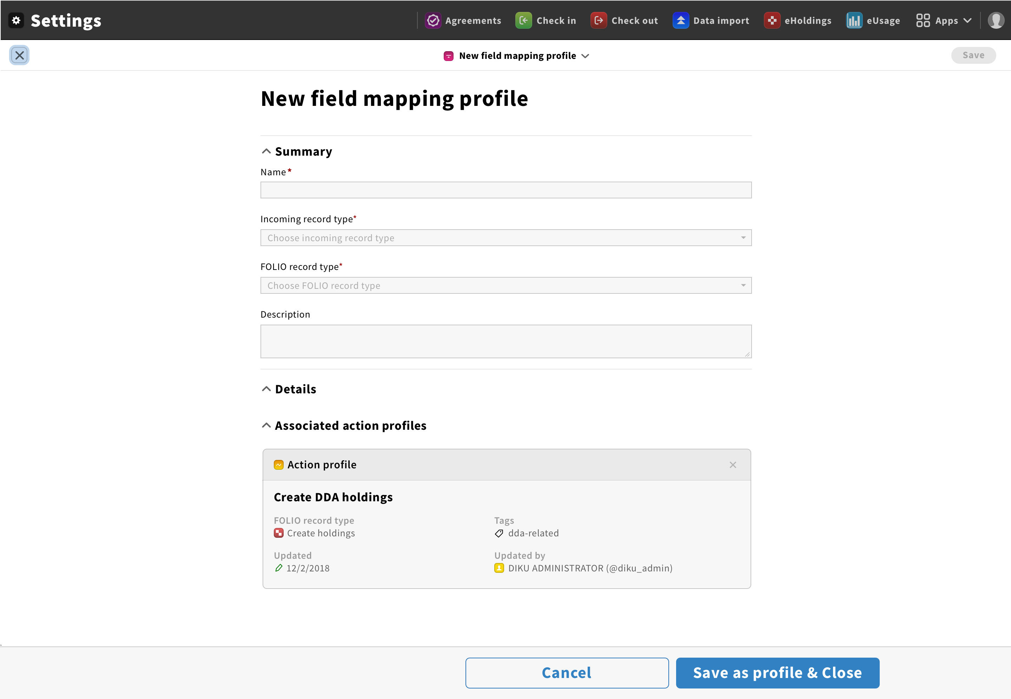
Field mapping profile: link action profile: 3
3. There will be some sort of “unlink” icon at end of row, so that the action profile can be disconnected from the field mapping profile
1. After action profile picked, modal closes, and linked profile shows at the bottom of the field mapping profile
2. Since multiple action profiles can be linked to field mapping profile, Link profile button still shows
Link profile

Slide 6
Field mapping profile: link action profile: 4
2 action profiles linked to a field mapping profile
Link profile

Slide 7
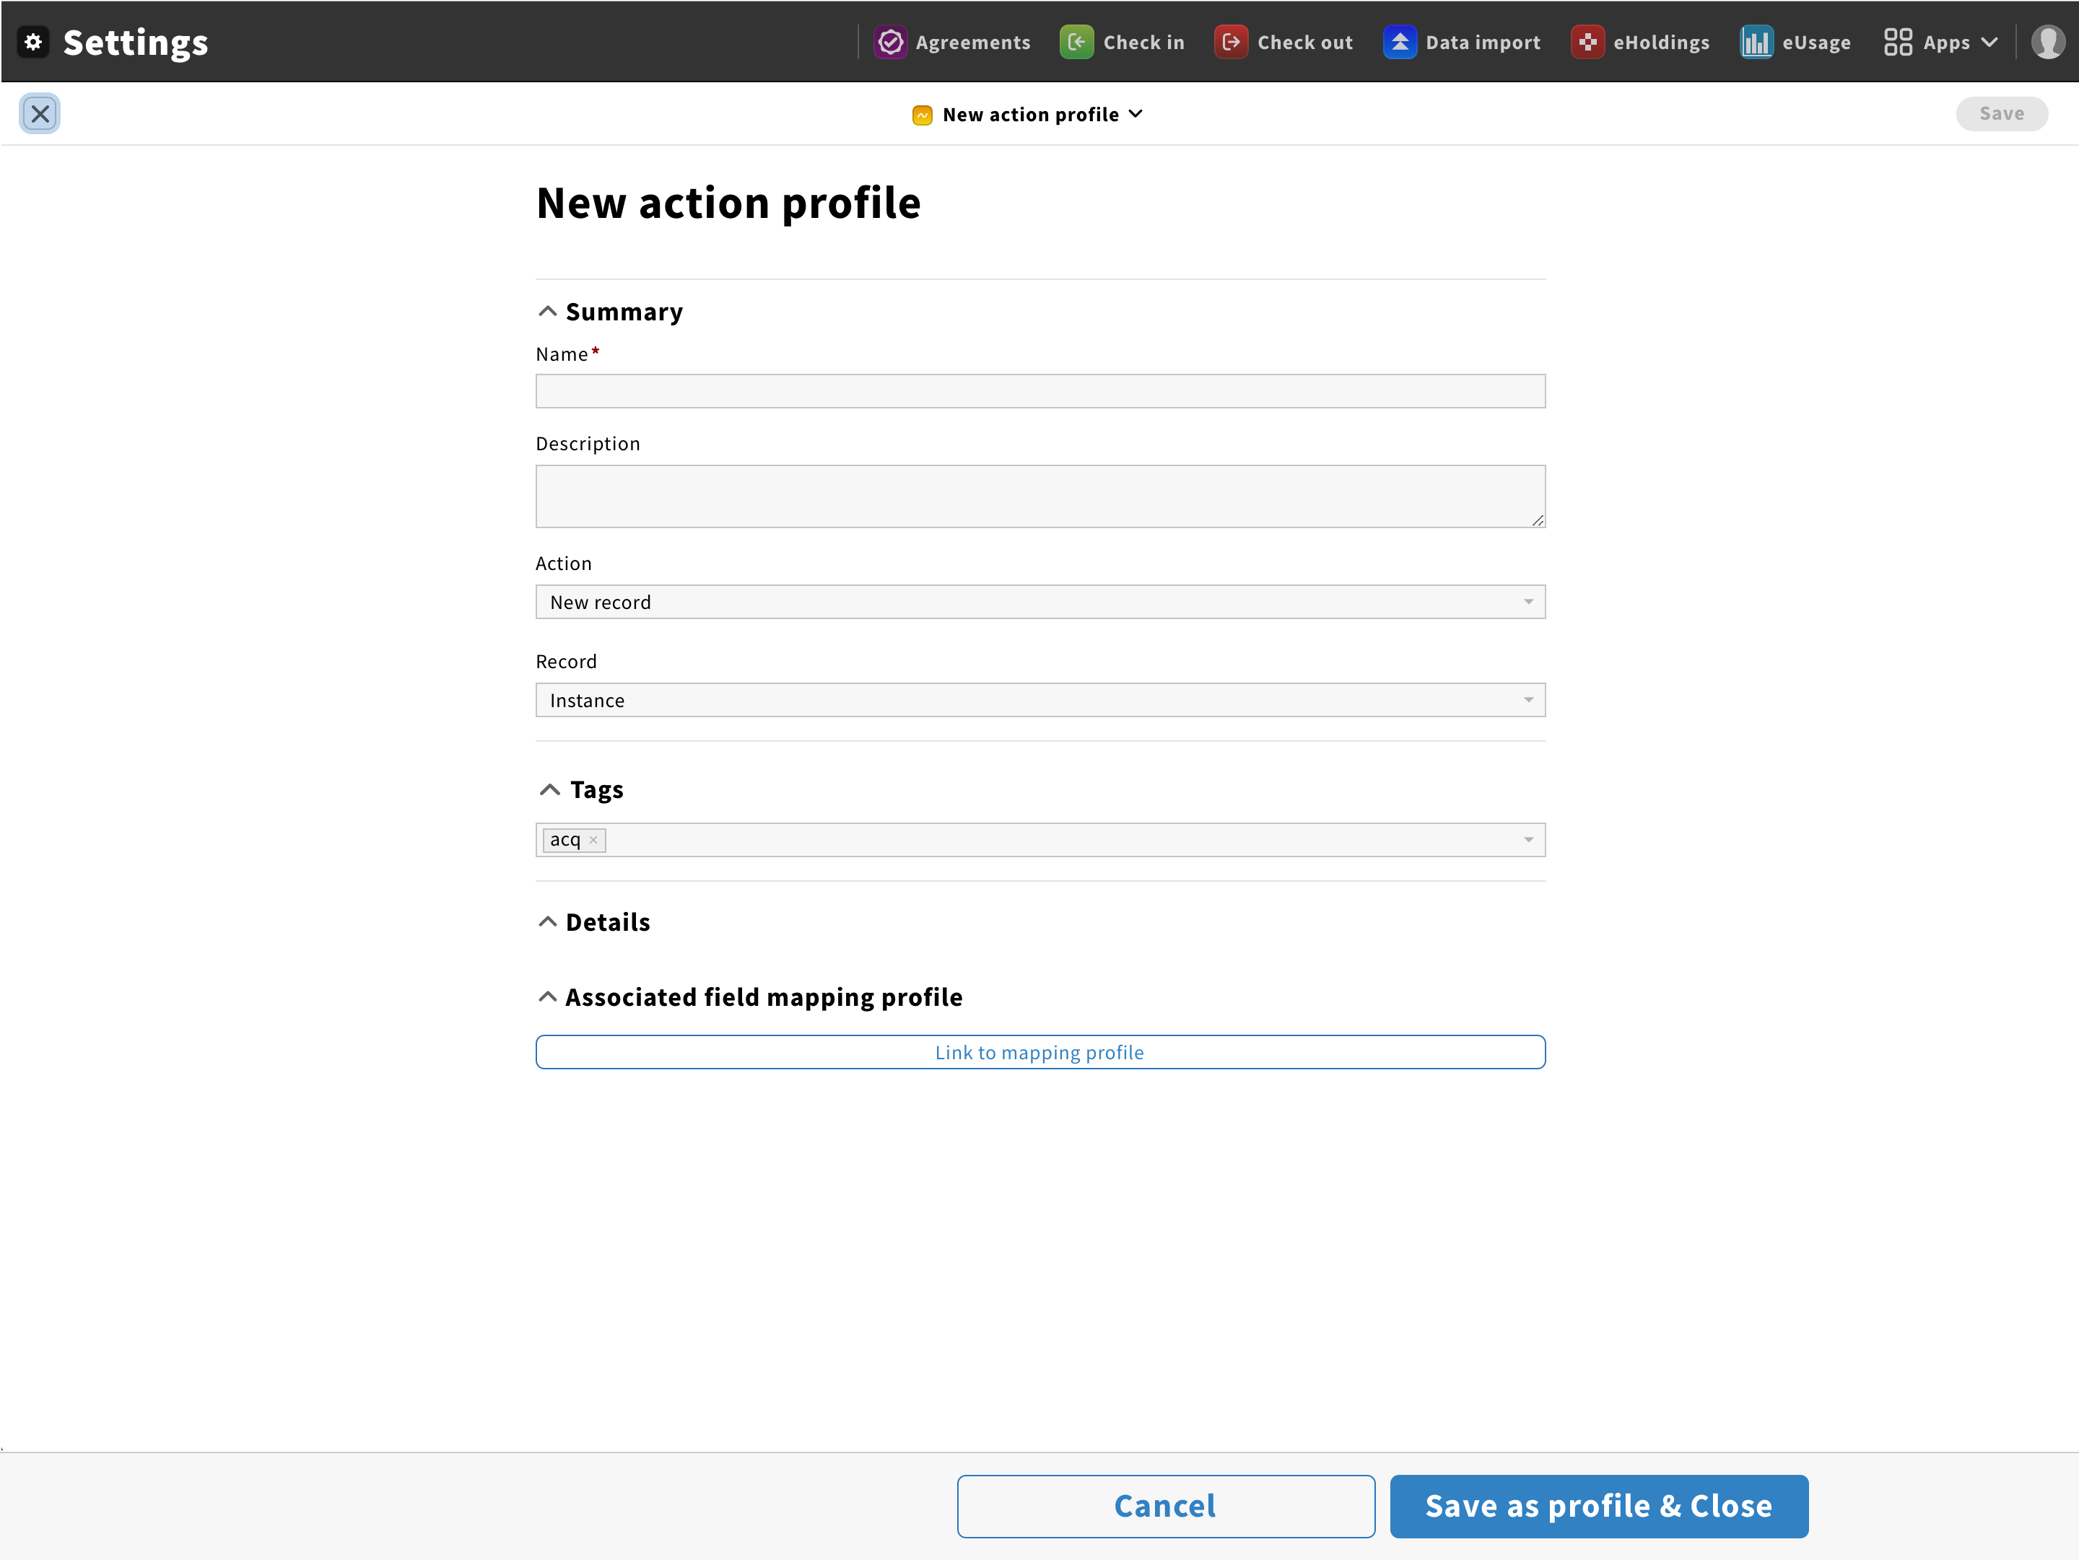
Action profile: link field mapping profile: 1
Add button to create/edit screen
Link profile

Slide 8
Action profile: link field mapping profile: 2
action
action
Field mapping
Opens profile picker modal, filtered to field mapping profiles only

Slide 9
Action profile: link field mapping profile: 3
3. There will be some sort of “unlink” icon at end of row, so that the field mapping profile can be disconnected from the action profile
1. After field mapping profile picked, modal closes, and linked profile shows at the bottom of the action profile
2. Since only 1 field mapping profile can be linked to action profile, Link profile button should NOT show

