Slide 1
Login approx. 13:25 local time: I deleted all my circ rules >> saved >> Wrote a new circ rule:
Old circ rules:
New circ rule:

Slide 2
When I check the item out, it still have the wrong (old) loan policy:

Slide 3
This can be confirmed in the loan details:

Slide 4
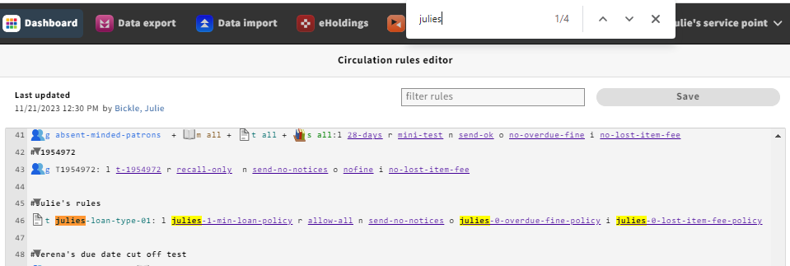
I checked that my test item had the right loan type:
By searching for „julies“, I checked that my item wasn‘t actually following another cird rule:

Slide 5
Bonus fun: When I first logged in and went to the circ rules, the circ rules panel didn‘t load and I got a load of „Failed to fetch“ errors. I tried to replicate by closing the tab and opening FOLIO in a new tab again, and then the circ rules appeared. So I did my testing.
Now, when replicating the issue for documenting in this PPT, similar error messages appeared when scanning the patron barcode. There were two error messages (‚requests‘ and ‚openLoans‘) but I could still check out successfully:
ERROR: in module @folio/inventory, operation GET on resource 'openLoans' failed, saying: Failed to fetch

