Slide 1
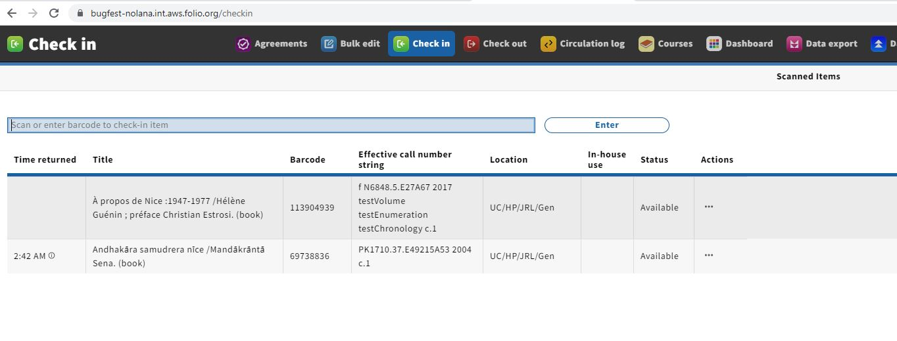
1_Nolana_CheckIn_MissingTimeReturned
FYI: The other loan in this example correctly has no overdue fine.

Slide 2
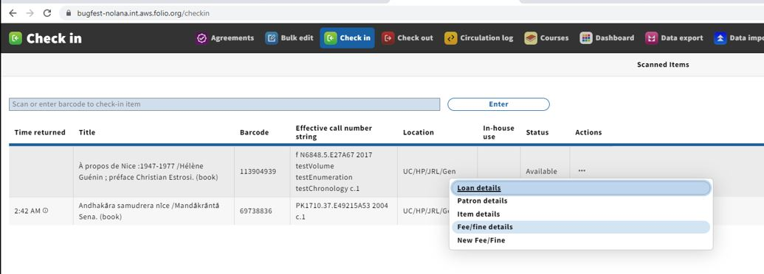
2_Nolana_CheckIn_MissingTimeReturned

Slide 3
3_Nolana_LoanDetails_NoFeesFinesIncurred

Slide 4
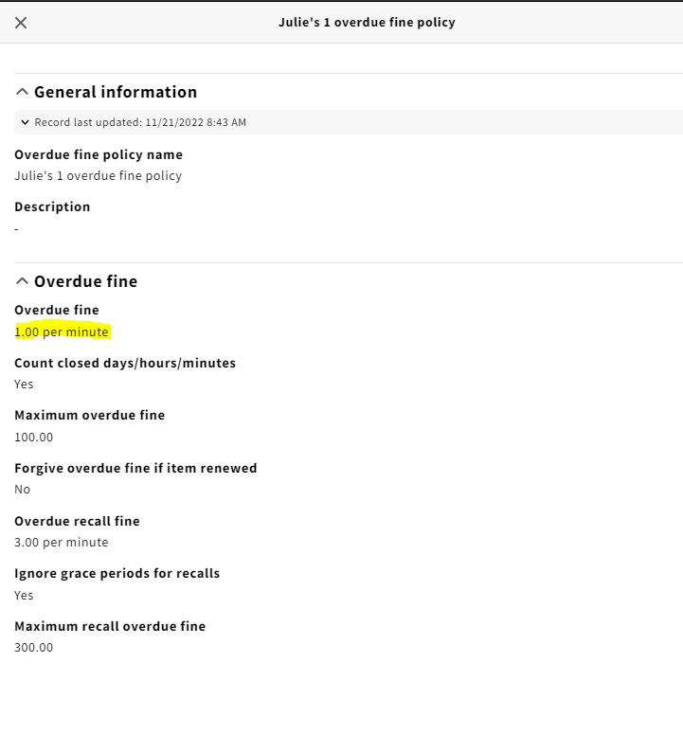
4_Nolana_Julies1OverdueFinePolicy

Slide 5
User UUID = | 7f47ac63-4c90-4a07-8418-80803c766053
User Name = | Bickle_Test, Julie_Student
Loan UUID = | 4583c70d-8333-418d-b046-3a49e92015ca
Item Title = | À propos de Nice :1947-1977 /Hélène Guénin ; préface Christian Estrosi. (book)
Loan Due Date = | 11/23/2022, 2:36 AM
Loan Return Date = | 11/23/2022, 2:42 AM
Circ rule = | g julies-patron-group + t julies-1st-loan-type + m book: l julies-1-min-loan-policy r allow-all n send-no-notices o julies-1-overdue-fine-policy i julies-0-lost-item-policy
Overude policy UUID = | d9d760ca-61de-42a2-a9f3-d15733254c1a

